Slide 1
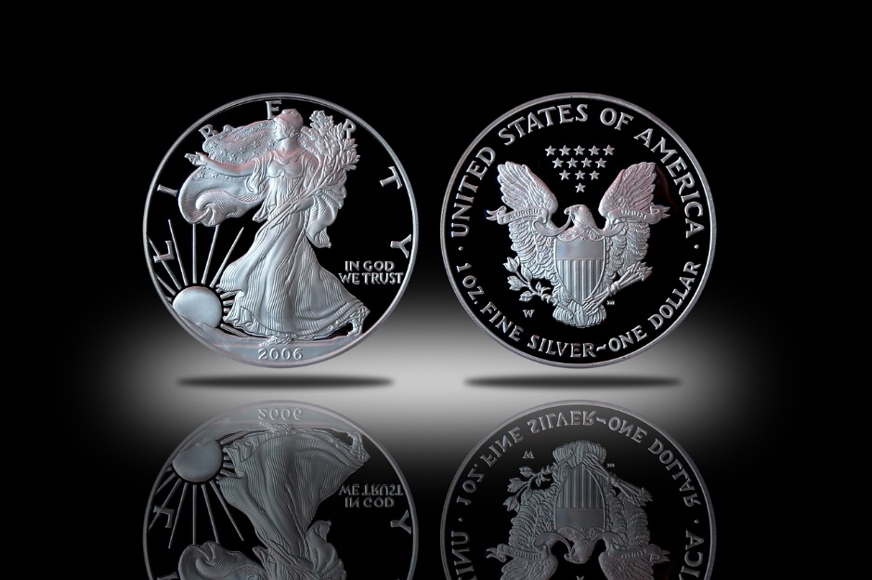
A Return to Sound Money
How It Can Be Done

Slide 2
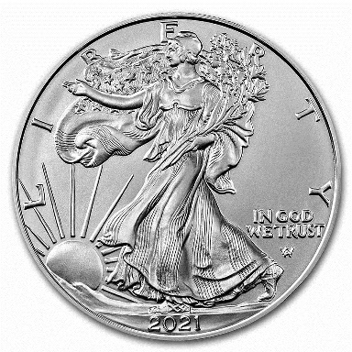
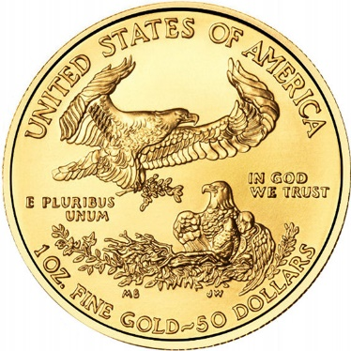
WHAT IS SOUND MONEY?
Owned by “We The People” and not “They the politicians and bankers”
Made of precious metals, specifically gold and silver
Minted either by private mints or by the official government mint
Contains a specific weight and purity of gold or silver
Holds its value over time and does not depreciate in value
Cannot be inflated to infinity as the current U.S. dollar is, as there is only a certain amount of gold and silver available for mining, refining and minting

Slide 3
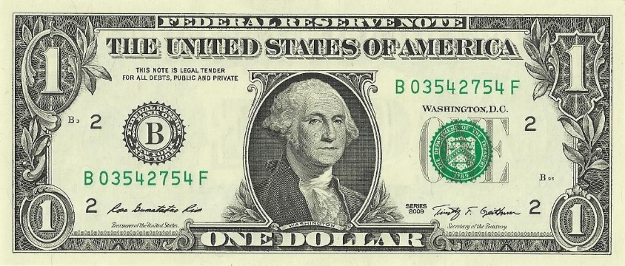
WHAT IS UNSOUND MONEY?
It is called fiat money: paper or electronic money unbacked by any precious metals
Is always issued by government – never by “We The People”
Is always inflated to unsustainable levels by government, in concert with a central bank
Results in steadily escalating prices of goods and services, as each fiat unit of currency is able to buy fewer and fewer goods and services
It leads to ongoing economic hardship and inequality in a nation

Slide 4
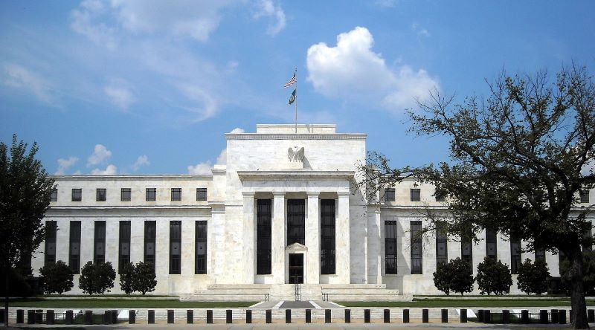
WHAT IS THE FEDERAL RESERVE?
A Congressionally-charted banking cartel
Creates “money” out of thin air, which the U.S. Treasury then issues to Congress and U.S. financial institutions
Federal Reserve Notes (the current U.S. dollar) cannot be redeemed for gold or silver, unlike earlier U.S. Treasury gold and silver certificates could be
The Fed is also the “lender of last resort” to banks – this creates “moral hazard” in that banks who would normally go out of business due to bad business decisions don’t.
The Fed is Congress’s “money spigot” to fund the pet pork-barrel spending projects of Congressmen and Senators

Slide 5
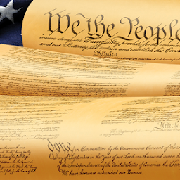
THE U.S. CONSTITUTION ON MONEY
ARTICLE I, SECTION 8:
“Congress shall have Power to … coin Money, regulate the value thereof … and fix the Standard of Weights and Measures.”
“Congress shall have Power to … provide for the Punishment of counterfeiting the Securities and current Coin of the United States.”
ARTICLE I, SECTION 10:
“No State shall … make any Thing but gold and silver Coin a Tender in Payment of Debts.”
“No State shall … emit Bills of Credit.” (Bills of Credit = fiat money)

Slide 6
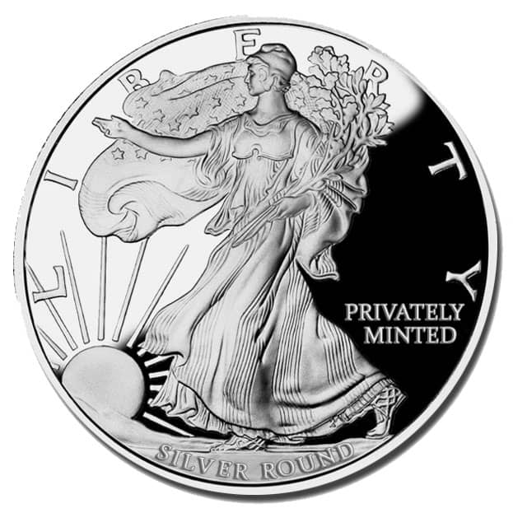
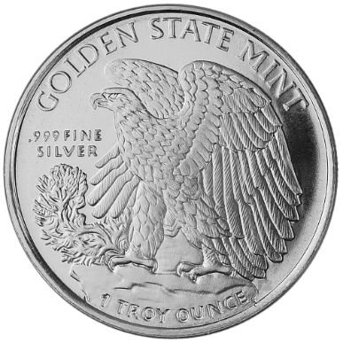
Sound Money Supports The Preamble
By using sound money you support our Constitution’s Preamble:
To form “a more perfect union”
To “establish justice”
To “insure domestic tranquility”
To “promote the general welfare”
To “secure the blessings of Liberty to ourselves and our Posterity”

Slide 7
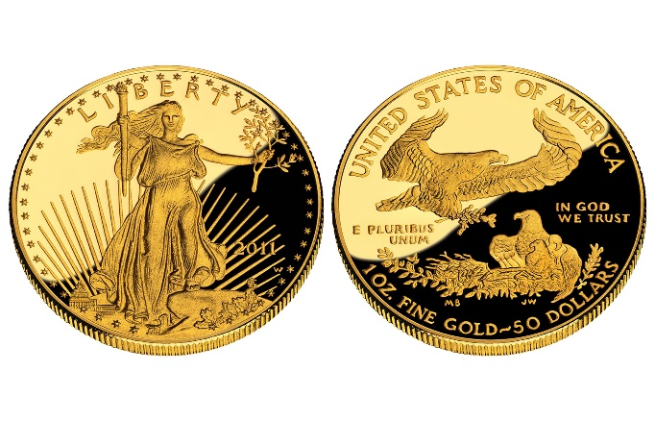
Sound Money Supports the Bill of Rights
By using sound money you will be exercising your:
Speech and petitioning rights in the First Amendment
Security of our property right in the Fourth Amendment
Our due process right in the Fifth Amendment
Our retention right in the Ninth Amendment
Our reservation right in the Tenth Amendment

Slide 8
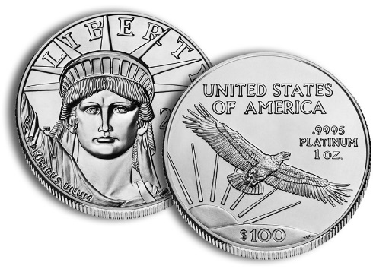
THE BENEFITS OF SOUND MONEY
Holds its value over time – a dollar tomorrow (or next month or year) will buy the same amount of goods and services as it does today
Has a fixed basis in real value
Is owned by “We The People” and not “Them The Politicians and Bankers”
Maintains economic stability and prosperity in a nation
Greatly helps to restore and maintain limited, constitutional government
Puts all citizens on a much more equal economic basis

Slide 9
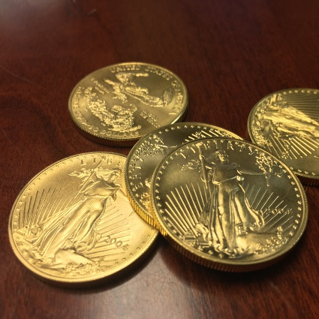
HOW TO RETURN TO SOUND MONEY
Several private mints exist around the U.S. They issue minted fine silver pieces called “silver rounds” These are available in several different sizes and weights of pure silver
Purchase some of these silver rounds from these private mints (or through precious metal dealers if you wish)
Ask local independent retail merchants where you do business if they would take payment for some or all of your purchases in these fine silver rounds.
That’s it! A simple and effective way to start returning ownership of the money to “We The People”!

Slide 10
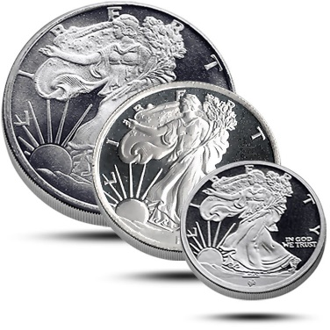
Assigning Dollar Value to Silver Rounds
By law, privately-minted silver rounds are not stamped with a U.S. dollar value. Use the following schedule of dollar values (based upon the current spot price of $20.00 - $25.00 for silver):
$30.00 per one (1) troy-ounce silver round
$15.00 per one-half (1/2) troy-ounce silver round
$7.50 per one-quarter (1/4) troy-ounce silver round
$3.00 per one-tenth (1/10) troy-ounce silver round

Slide 11
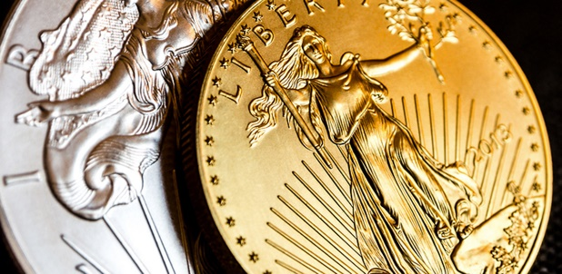
SOUND MONEY RESOURCES
Saco Bay Citizens for Sound Money: www.sacobaycitizens.org
Sound Money Defense League: www.soundmoneydefense.org
Restore Sound Money – End The Fed: www.jbs.org/fed/
The Ludwig von Mises Institute: www.mises.org
Foundation For Economic Education: www.fee.org
The Freedom Index: www.thenewamerican.com/freedom-index/
Golden State Mint: www.goldenstatemint.com
Quality Silver Bullion: www.qualitysilverbullion.com

Slide 12
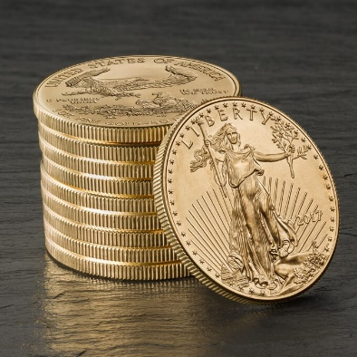
Sound Money Essays
“Billions for the Bankers; Debts for the People” by Rev. Sheldon Emry
“Gold and Economic Freedom” by Alan Greenspan
“Understanding Economic Principles” by The John Birch Society
“Inflation or Gold Standard” by Hans F. Sennholz
“Four Inflation Myths” by Lear Capital
“What is Sound Money?” by the Sound Money Defense League
“What Has Government Done to Our Money?” by Murray Rothbard
(Links to all essays are available at www.sacobaycitizens.org)

